Slide 1

Bike-sharing demand analysis
Yui Hanamura
Coursera student
Media3flower@gmail.com
IBM Data Analytics Course Using Excel and R
2025/8/20

Slide 2



OUTLINE
Executive Summary
Introduction
Methodology
Results
Visualization – Charts
Dashboard
Discussion
Selection of prediction models
Dashboard explanation
Conclusion
Appendix

Slide 3

EXECUTIVE SUMMARY
Background
Bicycle rental services are available in many cities around the world. One of the key elements of this business is to ensure that users can use the service at any time.
In order to optimize supply, we will develop a program that predicts the number of bicycles needed in real time based on factors such as weather conditions.
Summary of Results
The number of rentals is greatly affected by the season and weather. Usage decreases in winter. It is used more on weekdays than on holidays, so it is often used during commuting hours.
Next Steps
Maintain equipment in winter and reuse bicycles in each region.

Slide 4

2) INTRODUCTION
Bicycle rentals are available in many cities around the world. In each of these cities, it is important to ensure a steady supply so that people can always use rental bicycles.
We will build a prediction model using bicycle sharing demand data sets and calculate current demand based on weather forecasts.
Objective: Predicting the number of bicycles needed
Hypothesis: Greatly affected by weather
Relevant Paper and Citation Request:
Sathishkumar V E, Jangwoo Park, and Yongyun Cho. Using data mining techniques for bike sharing demand prediction in metropolitan city. Computer Communications, Vol.153, pp.353-366, March, 2020
Sathishkumar V E and Yongyun Cho. A rule-based model for Seoul Bike sharing demand prediction using weather data European Journal of Remote Sensing, pp. 1-18, Feb, 2020

Slide 5

3) METHODOLOGY
Constructed a linear regression model based on the Seoul Bike Sharing Demand Data Set.(https://data.seoul.go.kr/dataList/5/literacyView.do)
Automatically obtained weather forecasts using Open Weather API Data.(https://openweathermap.org/)
Extracted bicycle rental cities around the world using the Global Bike Sharing Systems Dataset.(https://en.wikipedia.org/wiki/List_of_bicycle-sharing_systems)
Filled in city location information using World Cities Data.
Use these dataset to build a linear regression model of the number of bikes rented each hour, based on the weather.

Slide 6
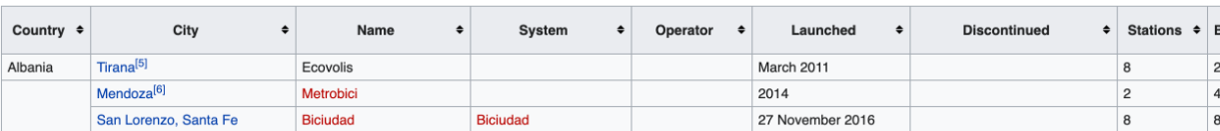
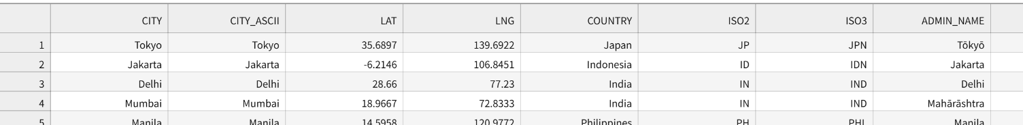
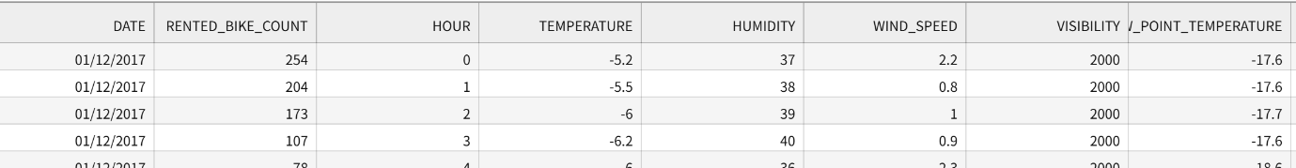
the Global Bike Sharing Systems Dataset
World Cities Data
Seoul Bike Sharing Demand Data Set
World Cities Data

Slide 7
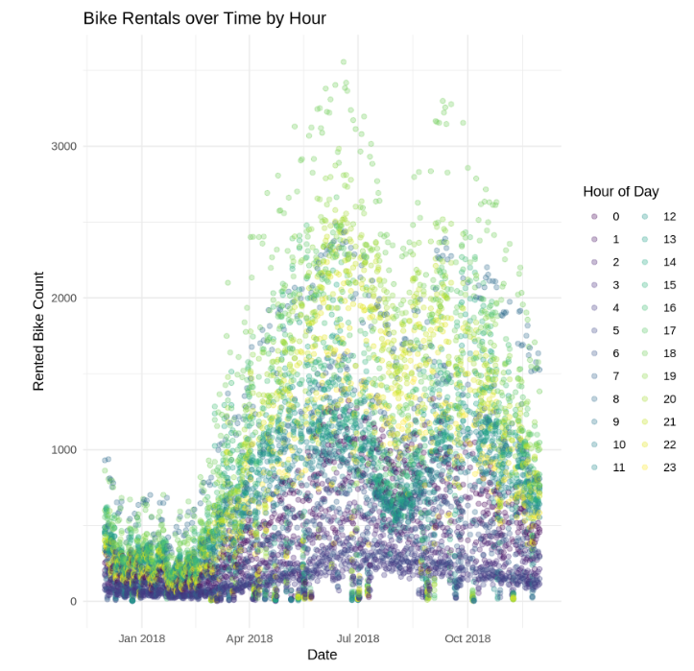
4) RESULTS 1) Visualization – Charts
Number of rentals per day
Usage during late night hours is low throughout the year.
Usage is low throughout the winter.
There is a wide variation in usage between spring and autumn.
The average usage is high in summer, with stable usage during the daytime.

Slide 8
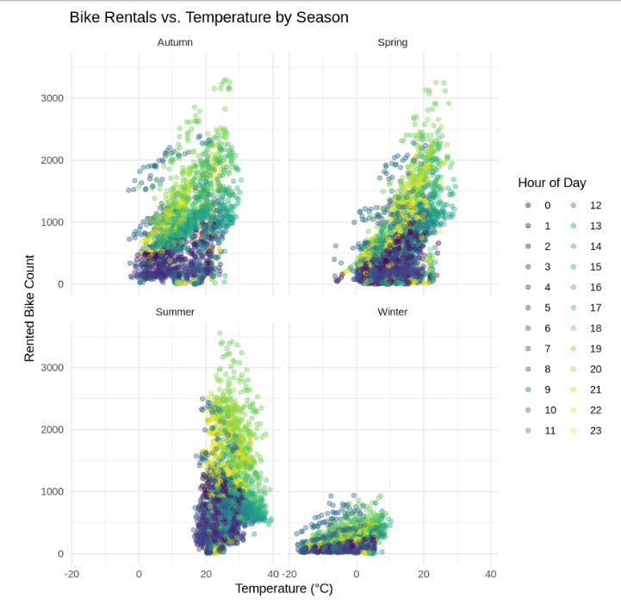
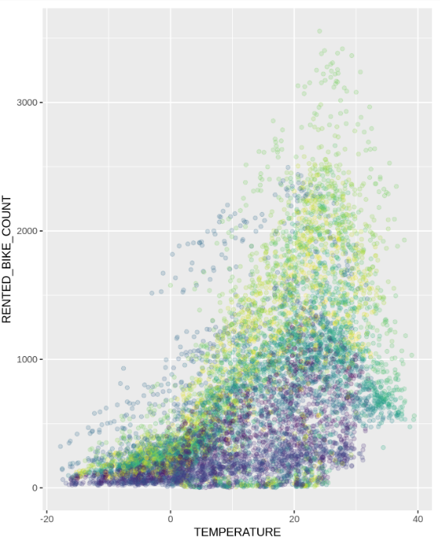
4) RESULTS 1) Visualization – Charts
← Number of rentals by season
↓ Relationship between temperature and number of rentals

Slide 9
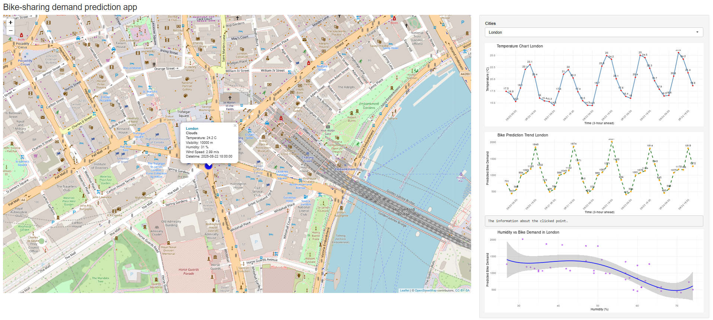
4) RESULTS 2) Dashboard

Slide 10
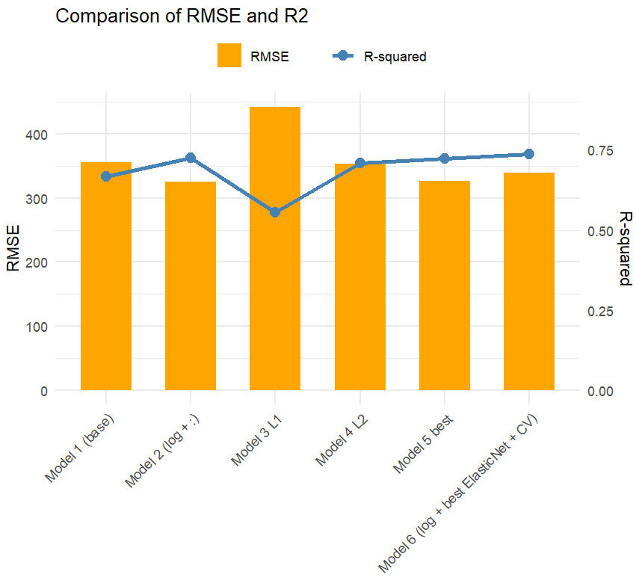

5) DISCUSSION 1) Selection of prediction models
Comparison Models
1: Linear regression
2: Linear regression + log transformation + interaction term
3: 2 + L1 weighting
4: 2 + L2 weighting
5: 2 + L1L2 grid search
6: 5 + cross validation BEST

Slide 11
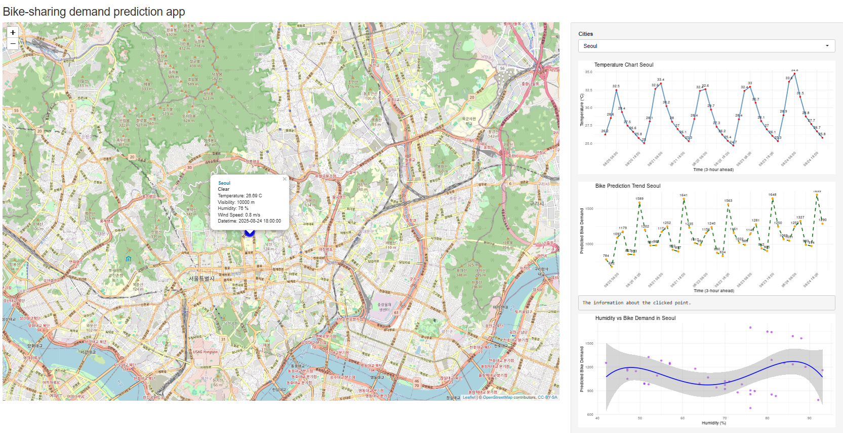
5) DISCUSSION 2) Dashboard explanation
Shiny App
Select a city by drilling down. ALL displays a world map.
Circular markers will be displayed on the map at the locations of each city. The size and color will vary depending on the number of bicycles available for rent.
Static temperature trend line:
the temperature trend in the next 5-days.
Interactive bike-sharing demand prediction trend line:
You can see its bike-sharing demand and datetime
Humidity and bike-sharing demand prediction correlation plot:
Using a prediction model

Slide 12

6) CONCLUSION
The number of bicycle rentals is greatly affected by the season and weather.
Usage rates decline in winter.
Usage is higher on weekdays than on holidays.
The number of rentals per day is lower than the overall average.
There is a pattern of growth, with usage concentrated during commuting hours.
By checking the app for rental forecasts for the next few days, you can ensure that you have enough supply.

Slide 13

7) APPENDIX
Includes the following explanations
Results for the entire dataset: Details of "seoul_bike_sharing" dataset
Calculate the daily total rainfall and snowfall with SQL query
Linear regression prediction model: R syntax for basic polynomial regression and numerical comparison table for six models

Slide 14
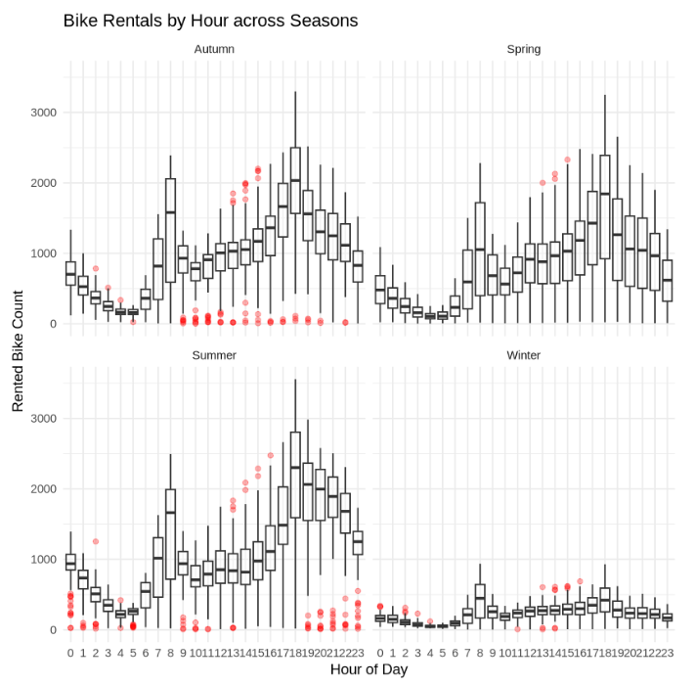
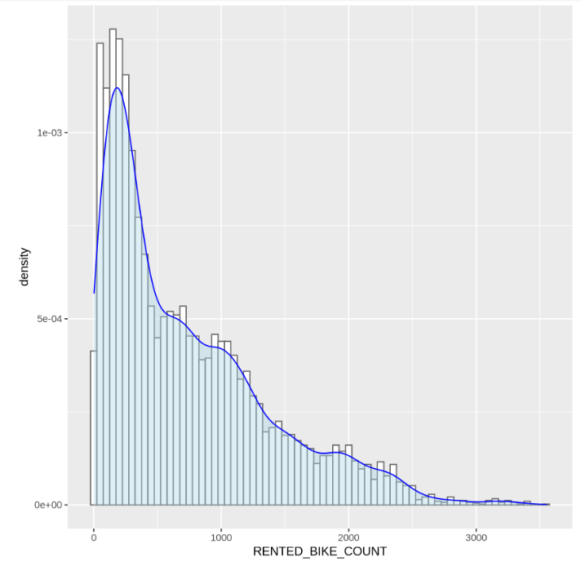
OVERALL FINDINGS IN DATASET
Details of "seoul_bike_sharing" dataset
← There are many outliers at night in summer and during the day in autumn.
↓ Histogram of total motorcycle rentals
“More days with values below the average” = Moderate usage on a daily basis.
“Multiple peaks” = Analysis should be divided by conditions such as time of day, day of the week, and weather.
“Long right tail” = The impact of unusual days (events, holidays, etc.) is significant, so this can be utilized for anomaly detection and peak prediction.

Slide 15
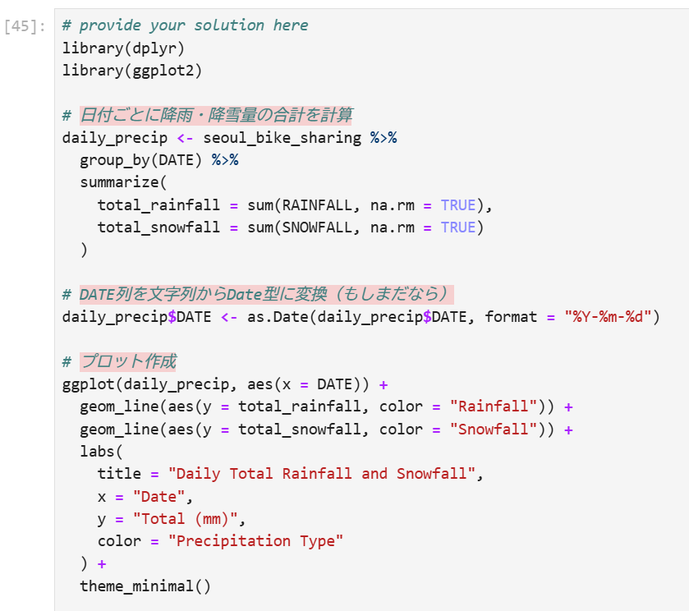
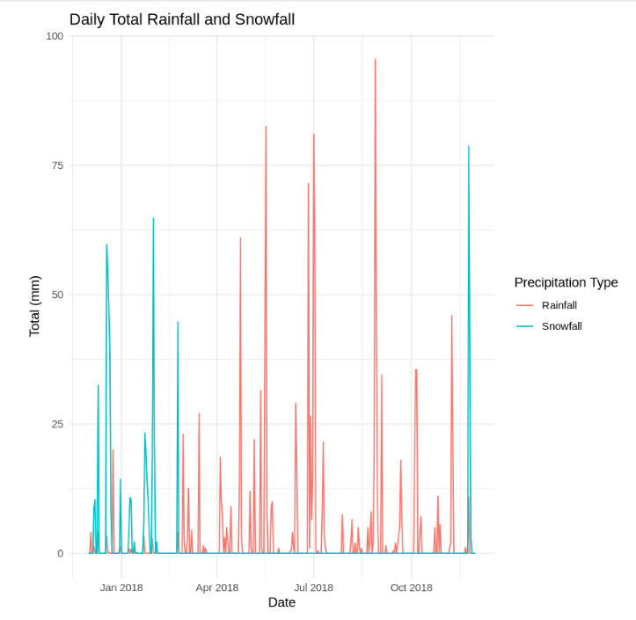
The daily total rainfall and snowfall
To check the effects

Slide 16
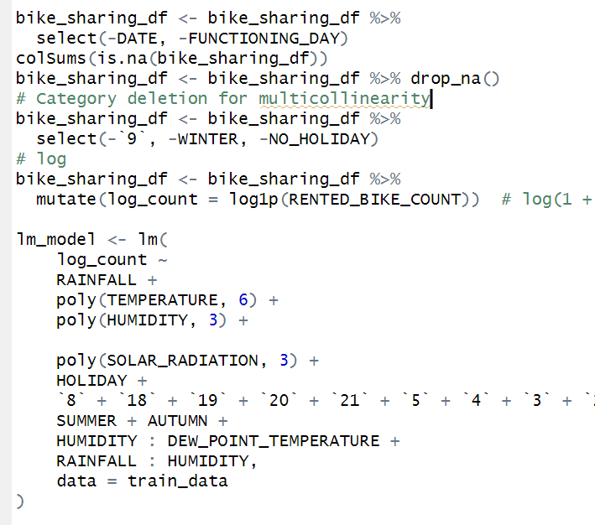
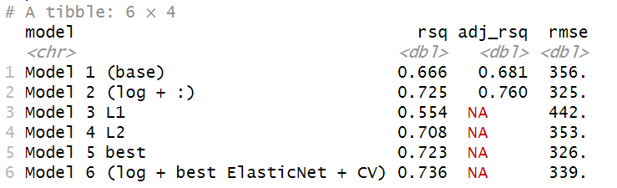
Linear regression prediction model
Based on the comparison results of the six models,
we determined that model 6, which added elastic net to the base polyomial (6th order, log transformation, interaction term) and cross-validation, was the most optimal.

